Slide 1

The Future of Cryptocurrencies
Price Forecasting & Analysis of Ethereum and Bitcoin

Slide 2



MEET THE TEAM
SHUBHAM MOHITE
SAI CHAITANYA REDDY KOURATLA
ALEX MASON
SAI KRISHNA SIDDANA

Slide 3


Generative AI
This presentation was made with the help of Google Cloud’s Generative AI.
Answers were used as inspiration and modified for inclusion.
Research was done to confirm any facts/claims that were generated.
Examples are in the appendix.

Slide 4

Bitcoin and Ethereum
Digital Decentralized Currencies
Bitcoin was first, but Ethereum has proven to be a challenger.
While similar, they have separate functionalities and ecosystems.

Slide 5


Business Question
Which cryptocurrency is the better investment?
We will use price forecasting to answer this question.
All work was done in the Google Cloud Platform.

Slide 6

Data
Data was sourced from CryptoCompare.com.
It has daily high and low prices for cryptocurrencies, as well as other metrics.
We collected a dataset going back 2,000 days to build our forecast from.

Slide 7
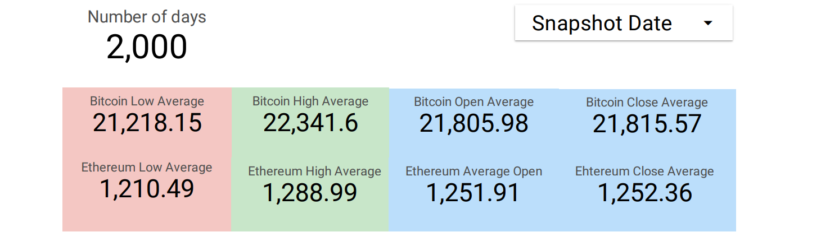
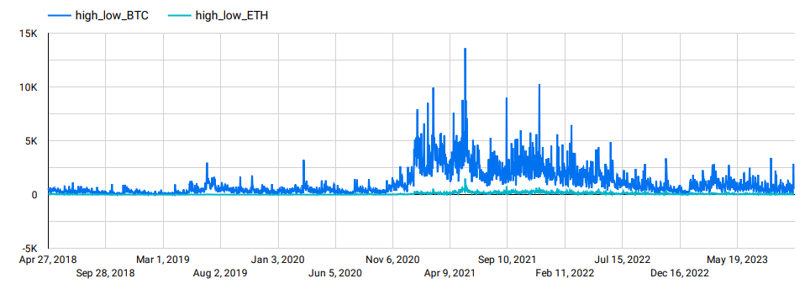
Historical Averages

Slide 8
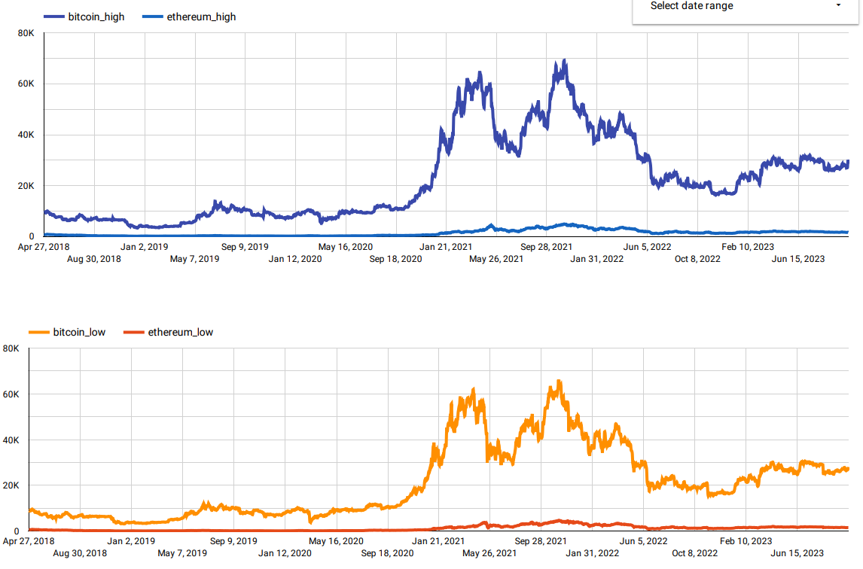
Historical Graphs
Daily High/Low Price (USD) Over 5 Years

Slide 9
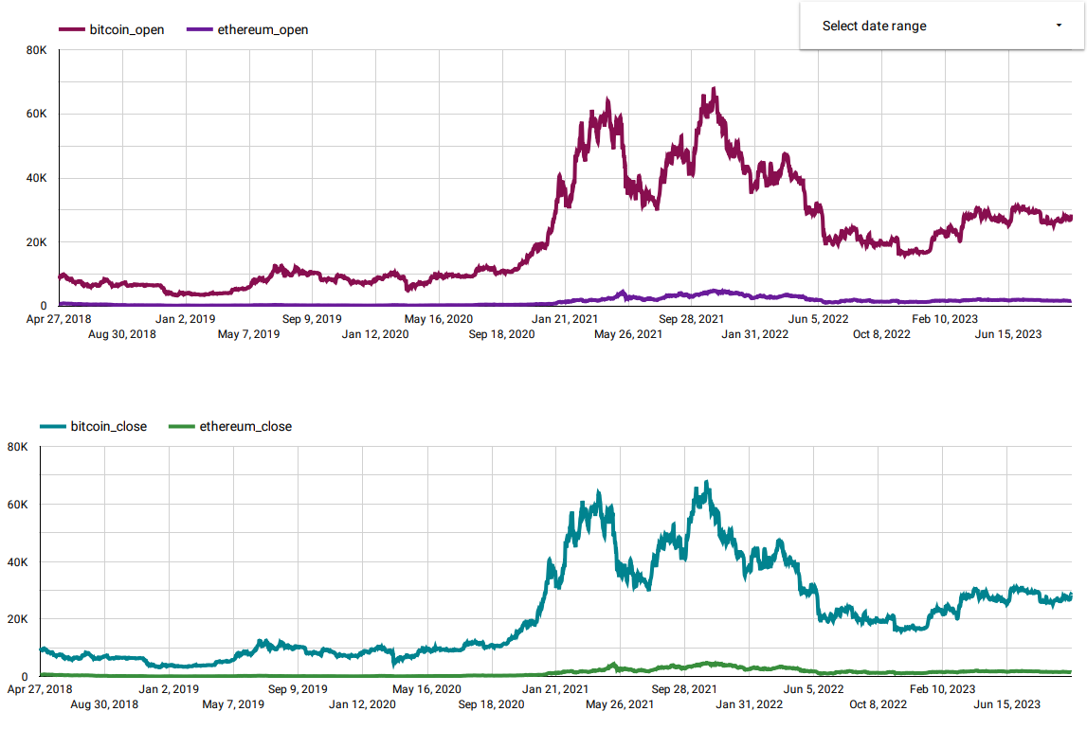
Historical Graphs
Daily Open/Close Price (USD) Over 5 Years

Slide 10
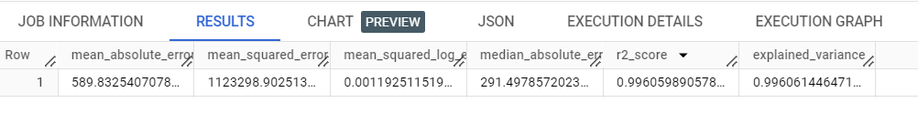
Modeling
We utilized linear and ARIMA models for our forecasting.
We used a range variable to incorporate volatility into our model.
We deployed a linear model into vertex AI and exposed it as endpoints.
Last we used a JSON script that calls endpoints and returns predictions.
Evaluation metrics for a linear model made for Ethereum
Evaluation metrics for a linear model made for Bitcoin

Slide 11
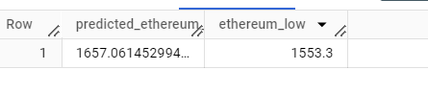
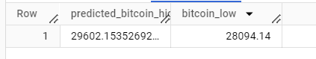
Forecast
Our modeling yielded a range for the predicted price 120 days from today.
Ethereum: 1,553 – 1,657.
Average of 1,605.
Bitcoin: 28,094 – 29,602.
Average of 28,848.

Slide 12
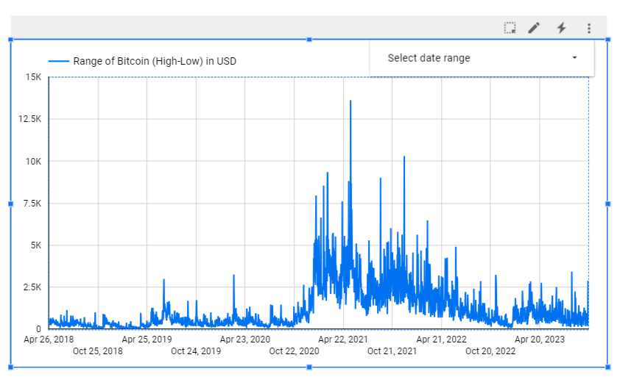
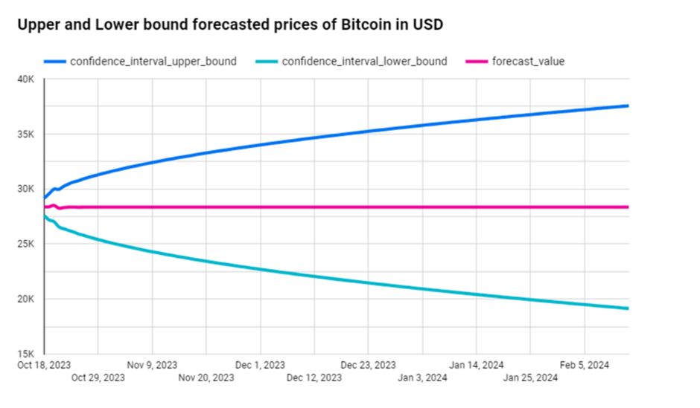
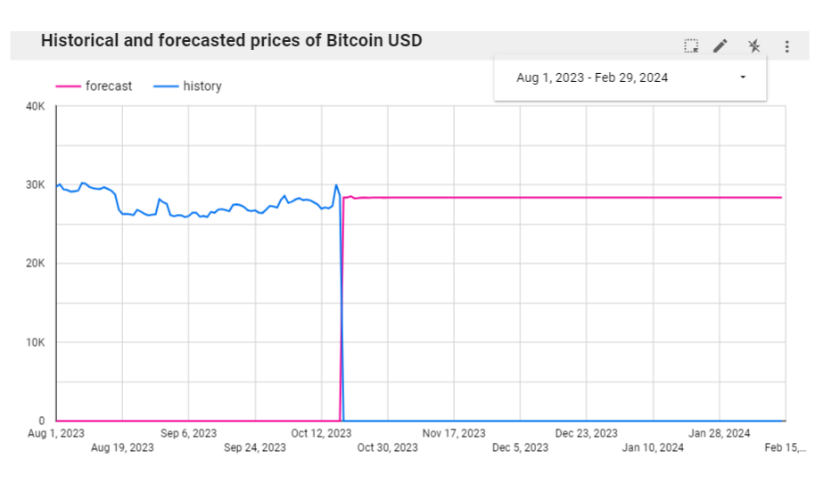
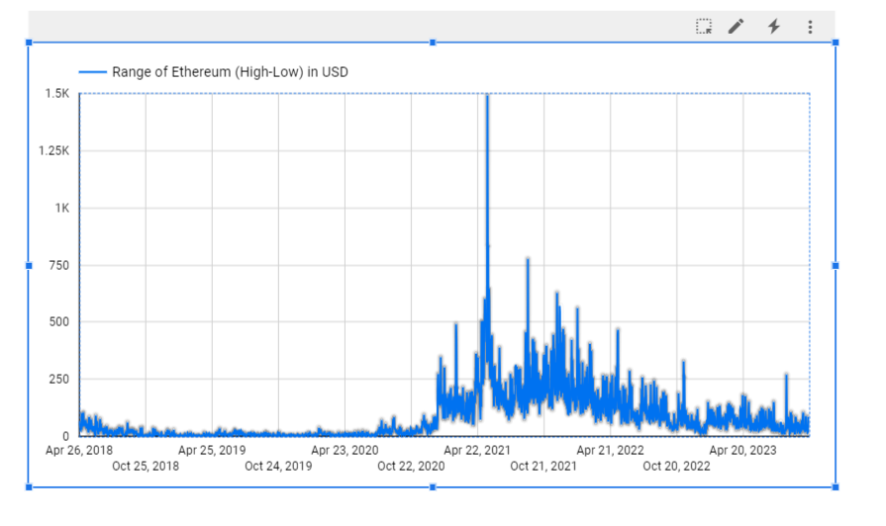
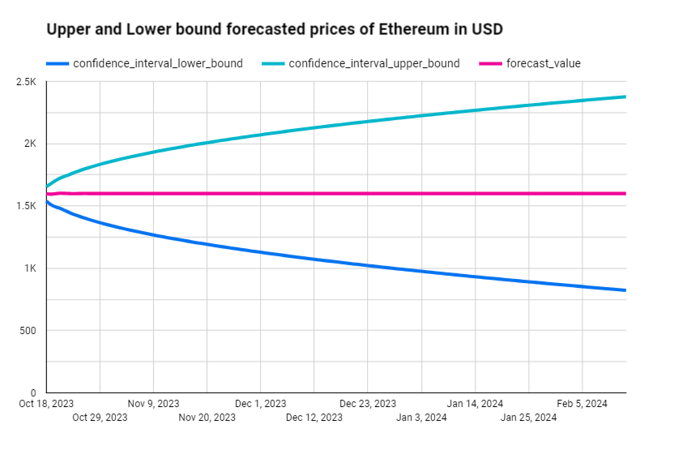
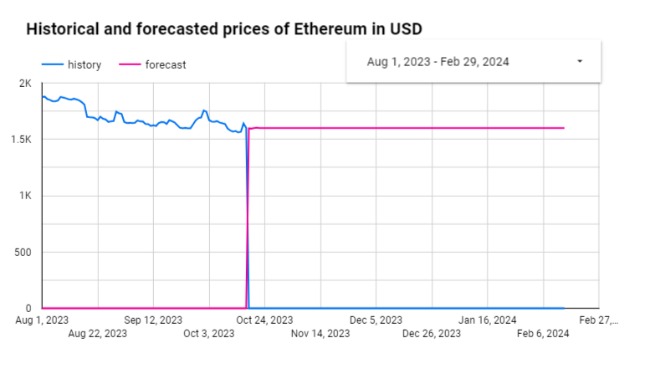
Predictions

Slide 13
Recommendations
Ethereum is currently selling for $1,549.93 and Bitcoin is selling for $28,248.50.
28,848 / 28,248.5 = 2.12% average profit for Bitcoin.
1,605 / 1,549.93 = 3.55% average profit for Ethereum.
Ethereum’s low prediction was above the current price while Bitcoin’s was below it.
Based on our modeling, Ethereum will yield better returns 120 days from now and is the safer choice for investing.

Slide 14

Other Considerations
Cryptocurrencies are less regulated and more volatile than traditional investments.
They are secure, using blockchain technology to store data.
Bitcoin and Ethereum have the highest market caps and are the most trusted of all cryptocurrencies.

Slide 15

Conclusion
Cryptocurrencies are risky investments that can yield big returns.
Ethereum and Bitcoin are the safest and most trusted coins in the market.
Our modeling predicts that Ethereum will have a higher percent yield in the coming months.
For this reason, we recommend investing in Ethereum over Bitcoin at this time.

Slide 16
Thank You
Questions?

Slide 17
Appendix
Google Looker Studio links to our reports.
https://lookerstudio.google.com/reporting/e4f42559-a712-4177-ae10-25889e8f3700
Dashboard 2
Dashboard 3
Dashboard 4
Dashboard 5
Dashboard 6
Dashbaord 7

Slide 18
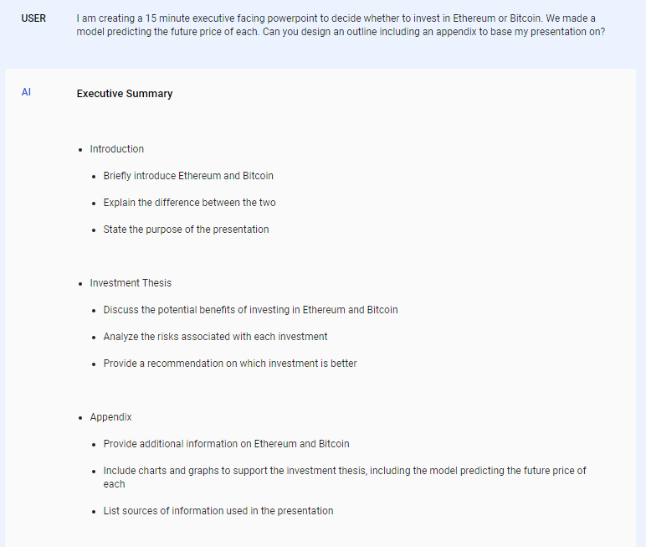
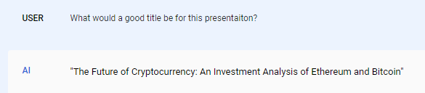
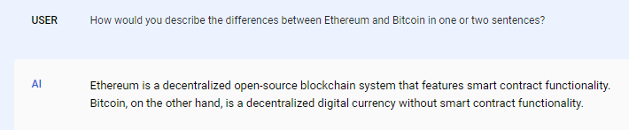
Appendix
Generative AI prompts and answers
Used as inspiration for an outline, title, as well as for slide 4 comparison.

Slide 19
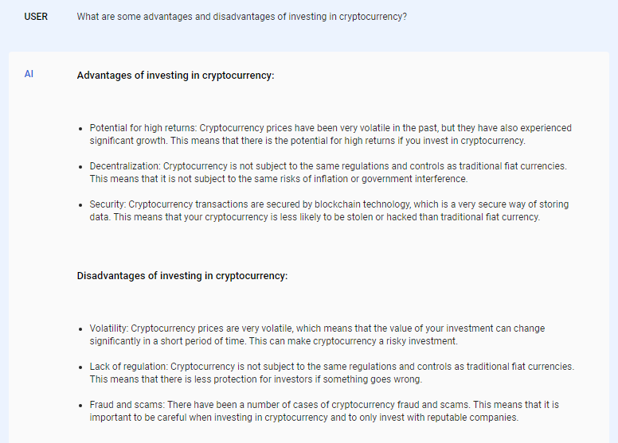
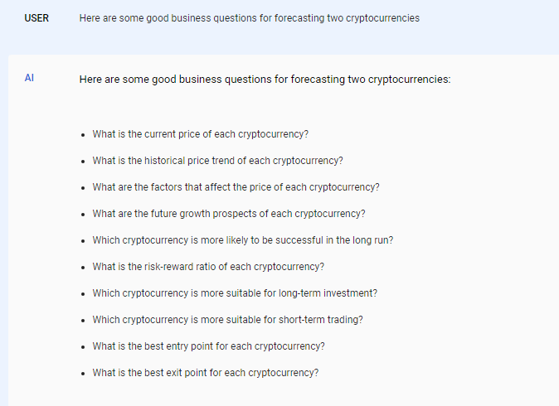
Appendix
Generative AI prompts and answers
Used as inspiration for business question and considerations slides

Slide 20
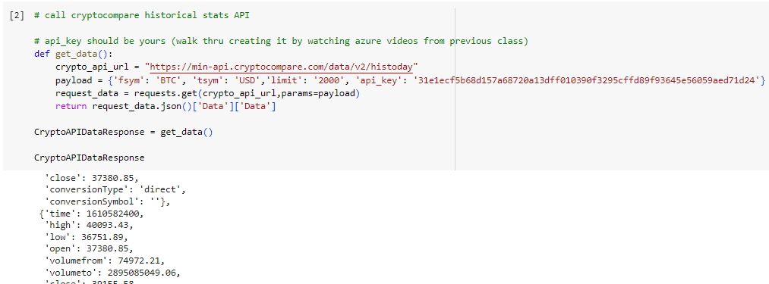
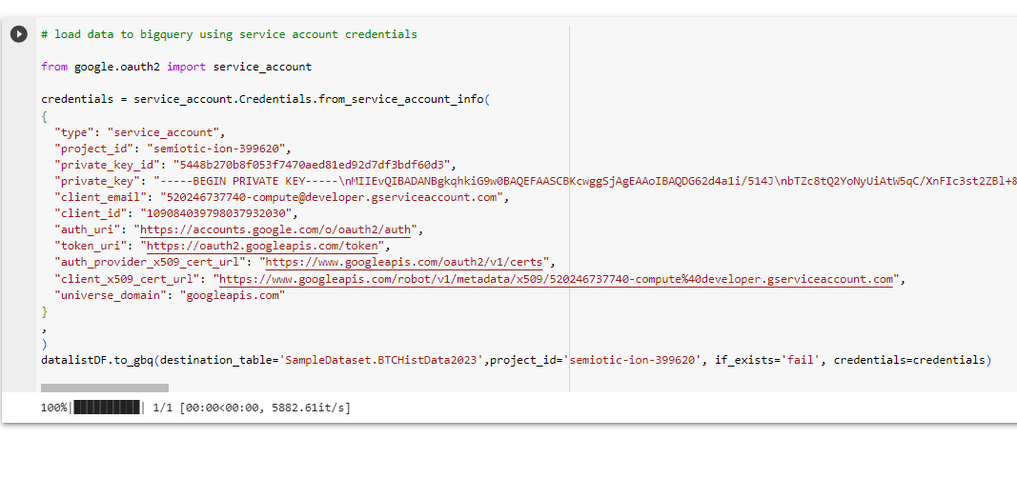
Appendix
Bitcoin Data Sourcing
Notes:
Initially to store the data we used crypto currency api to extract the data and store it into a table for that we used google collab to write code and convert it into a table

Slide 21
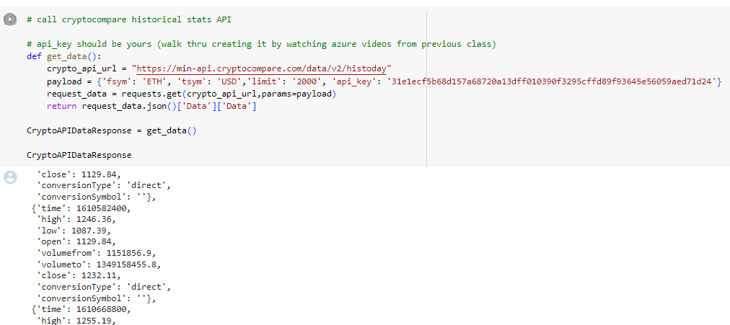
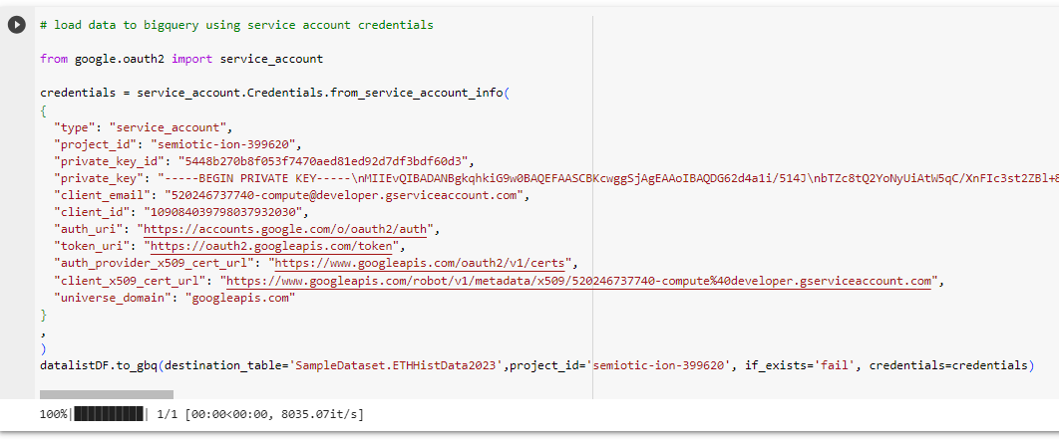
Appendix
Ethereum Data Sourcing

Slide 22
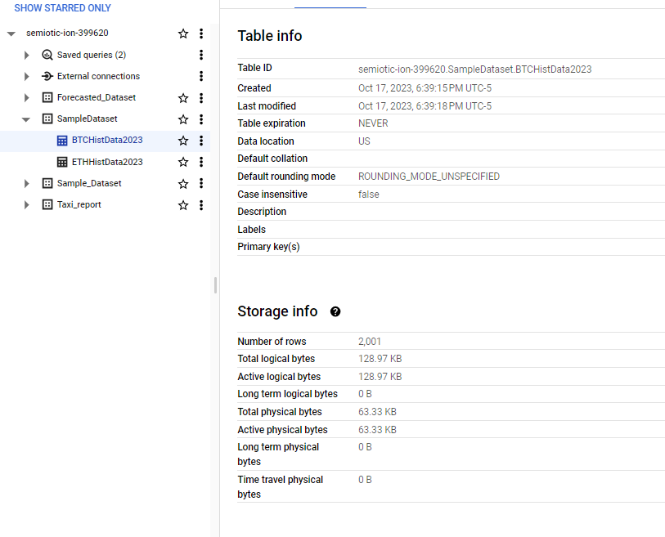
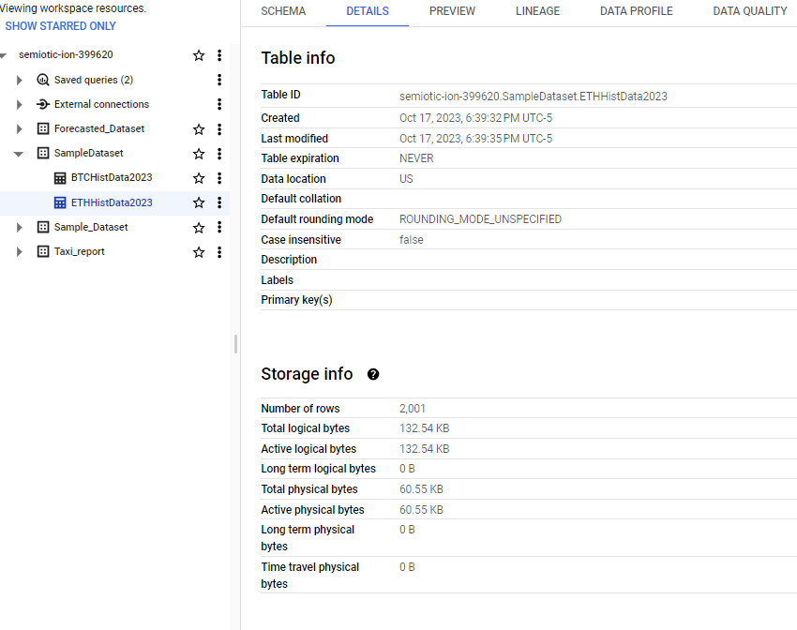
Appendix
Crypto Data Storage

Slide 23
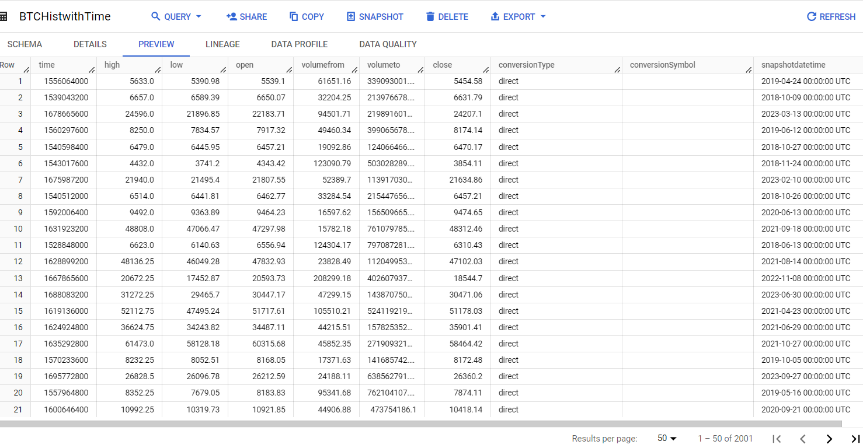
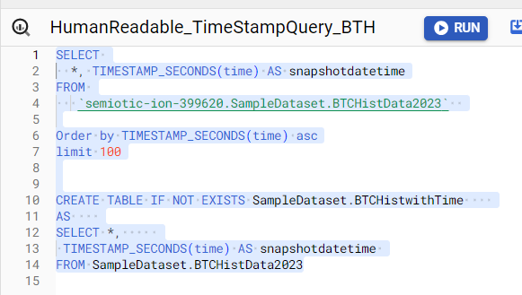
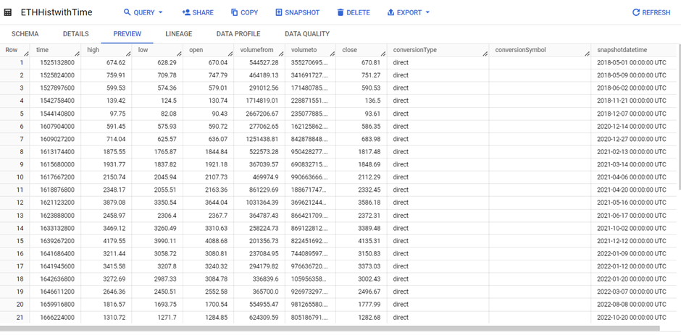
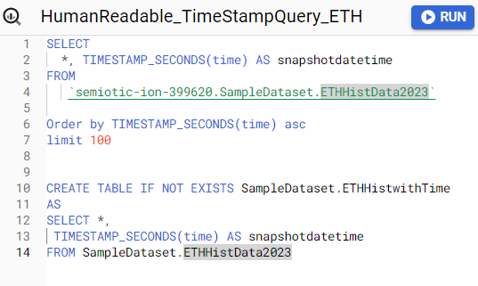
Appendix
Data Transformations
Notes:
We did data transformation and manipulation to the data to convert epoch time to human readable time and also use TIMESTAMP_SECONDS to convert the data type

Slide 24
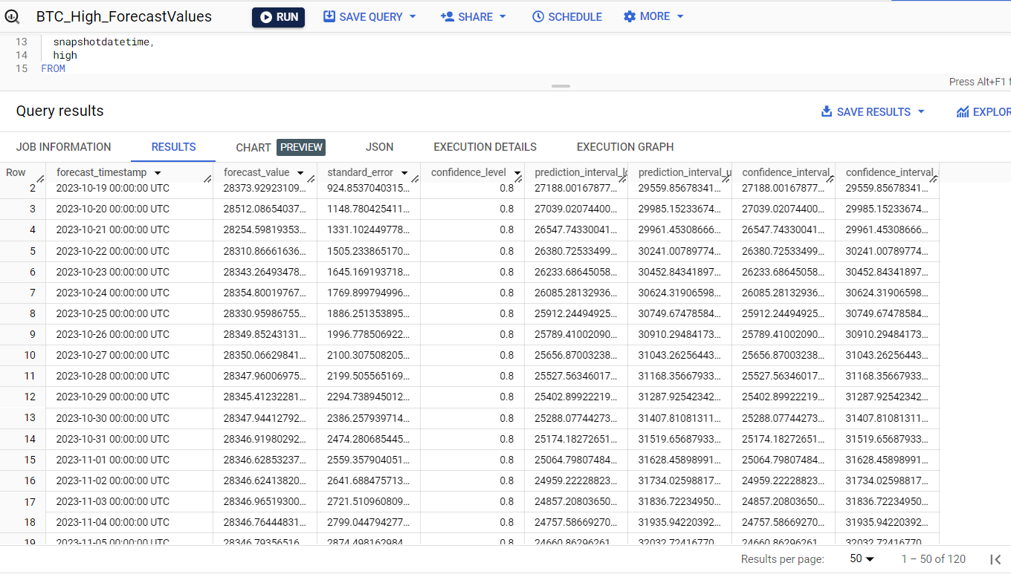
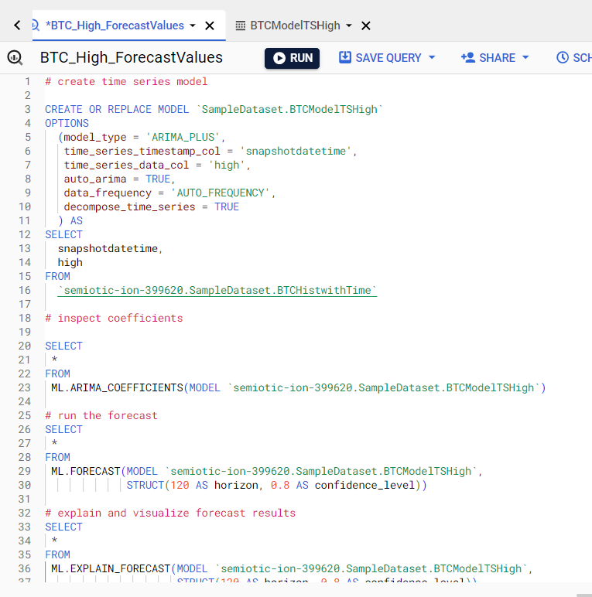
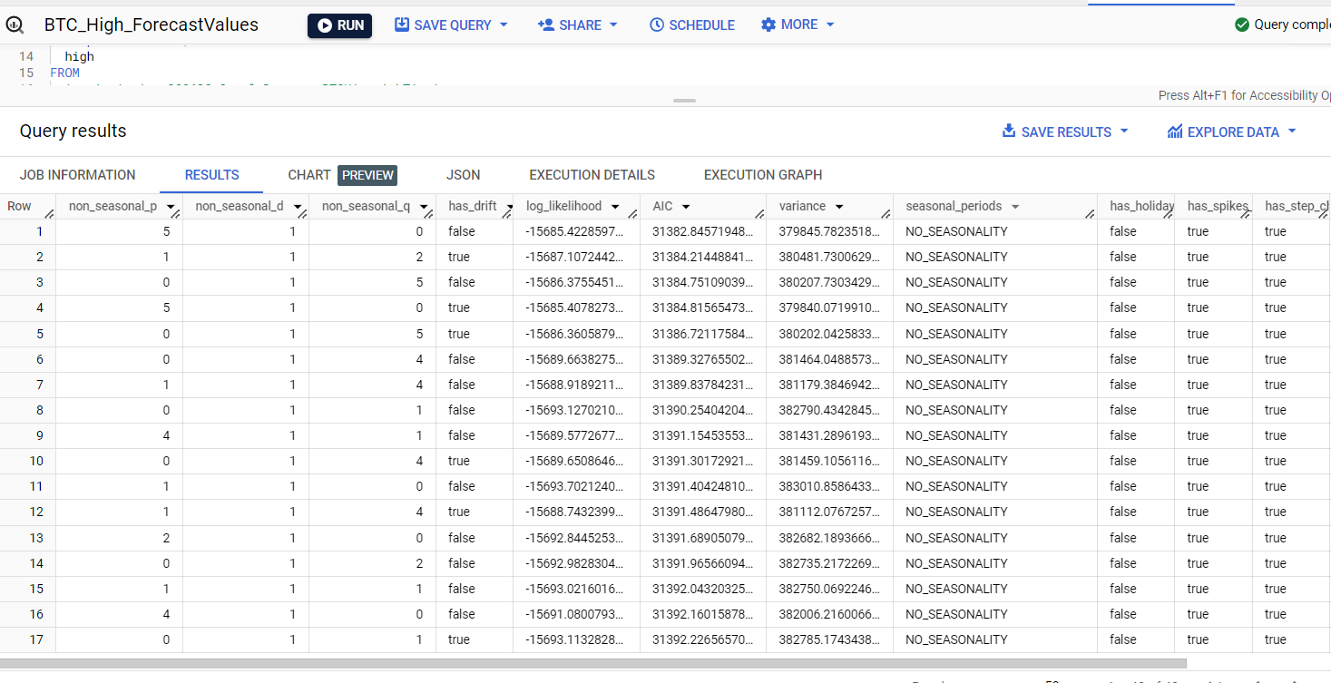
Appendix
Bitcoin high value forecasting model code, output, and goodness of fit.
Notes:
We used both Linear regression and

Slide 25
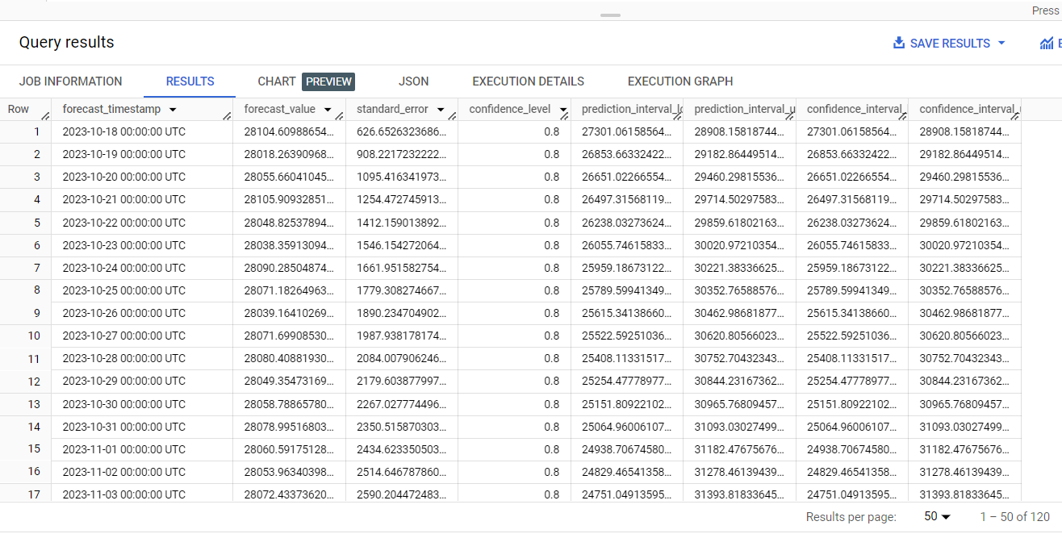
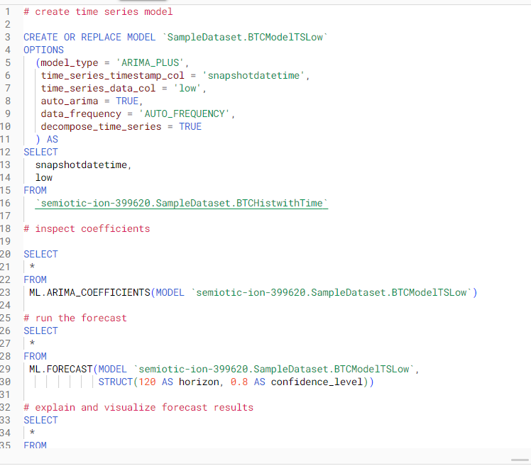
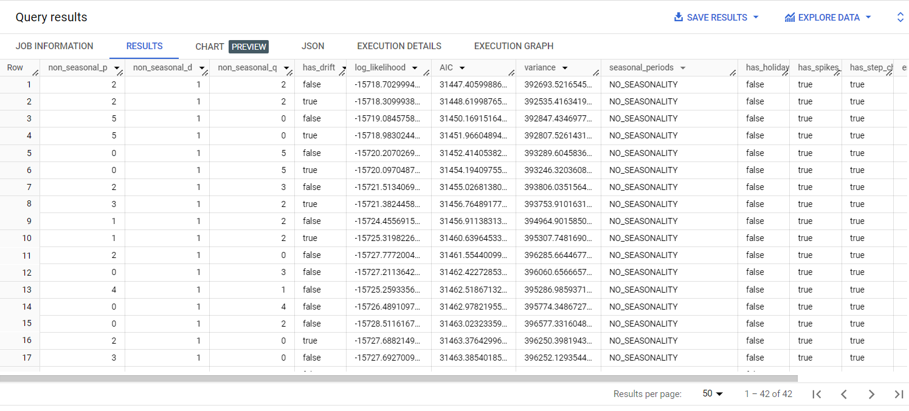
Appendix
Bitcoin low value forecasting model code, output, and goodness of fit.

Slide 26
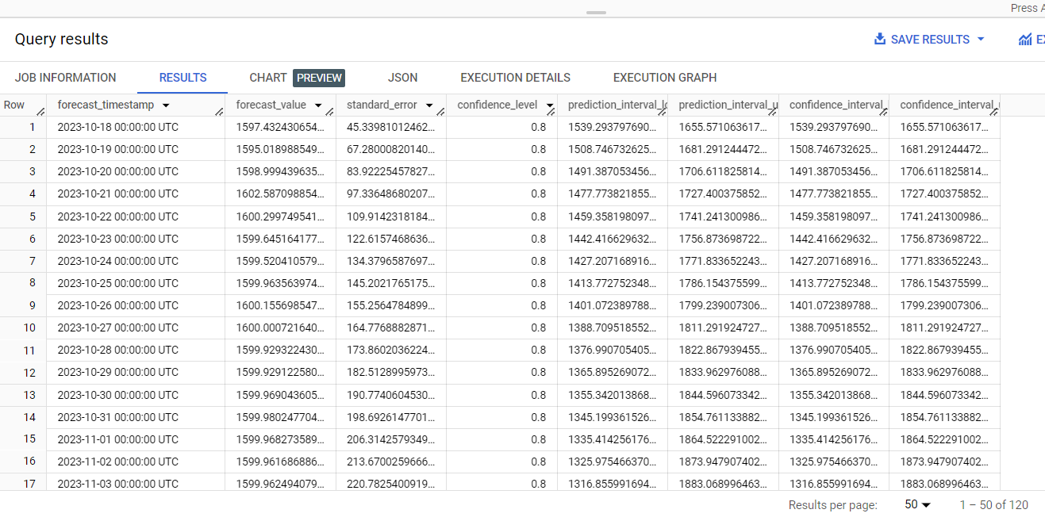
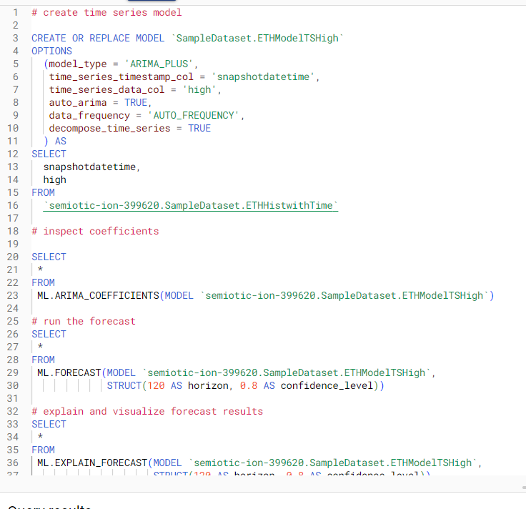
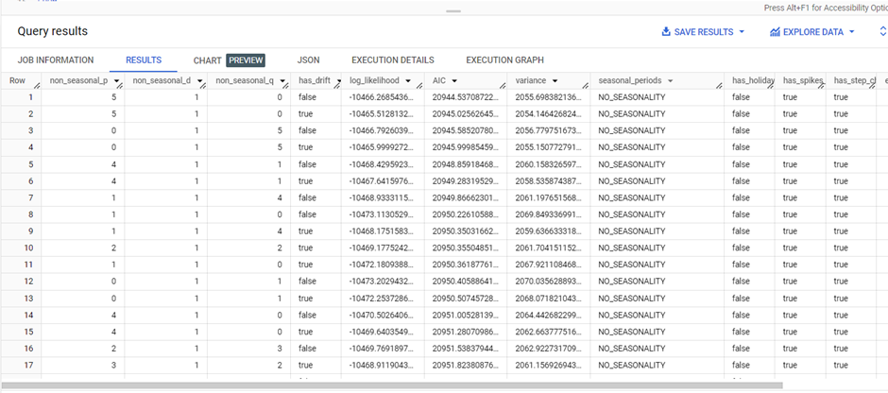
Appendix
Ethereum high value forecasting model code, output, and goodness of fit.

Slide 27
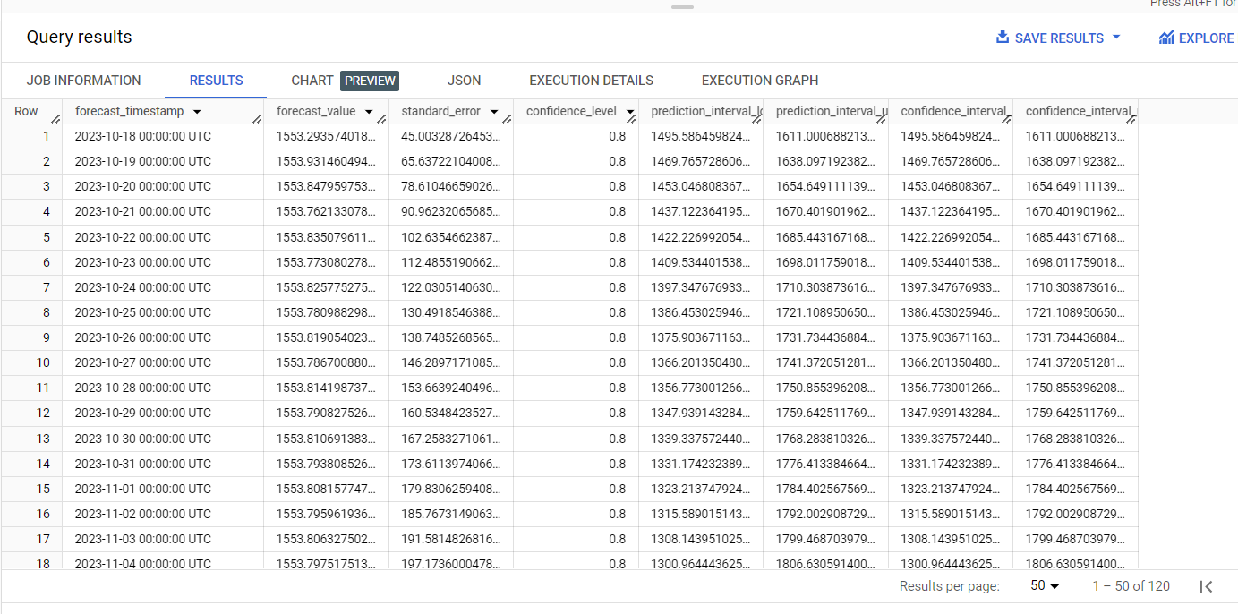
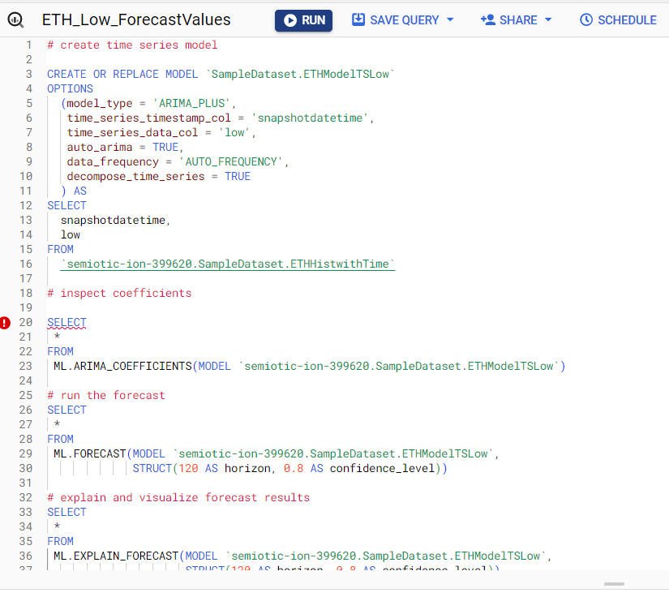
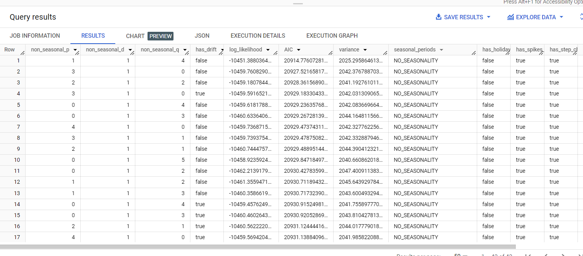
Appendix
Ethereum low value forecasting model code, output, and goodness of fit.

Slide 28
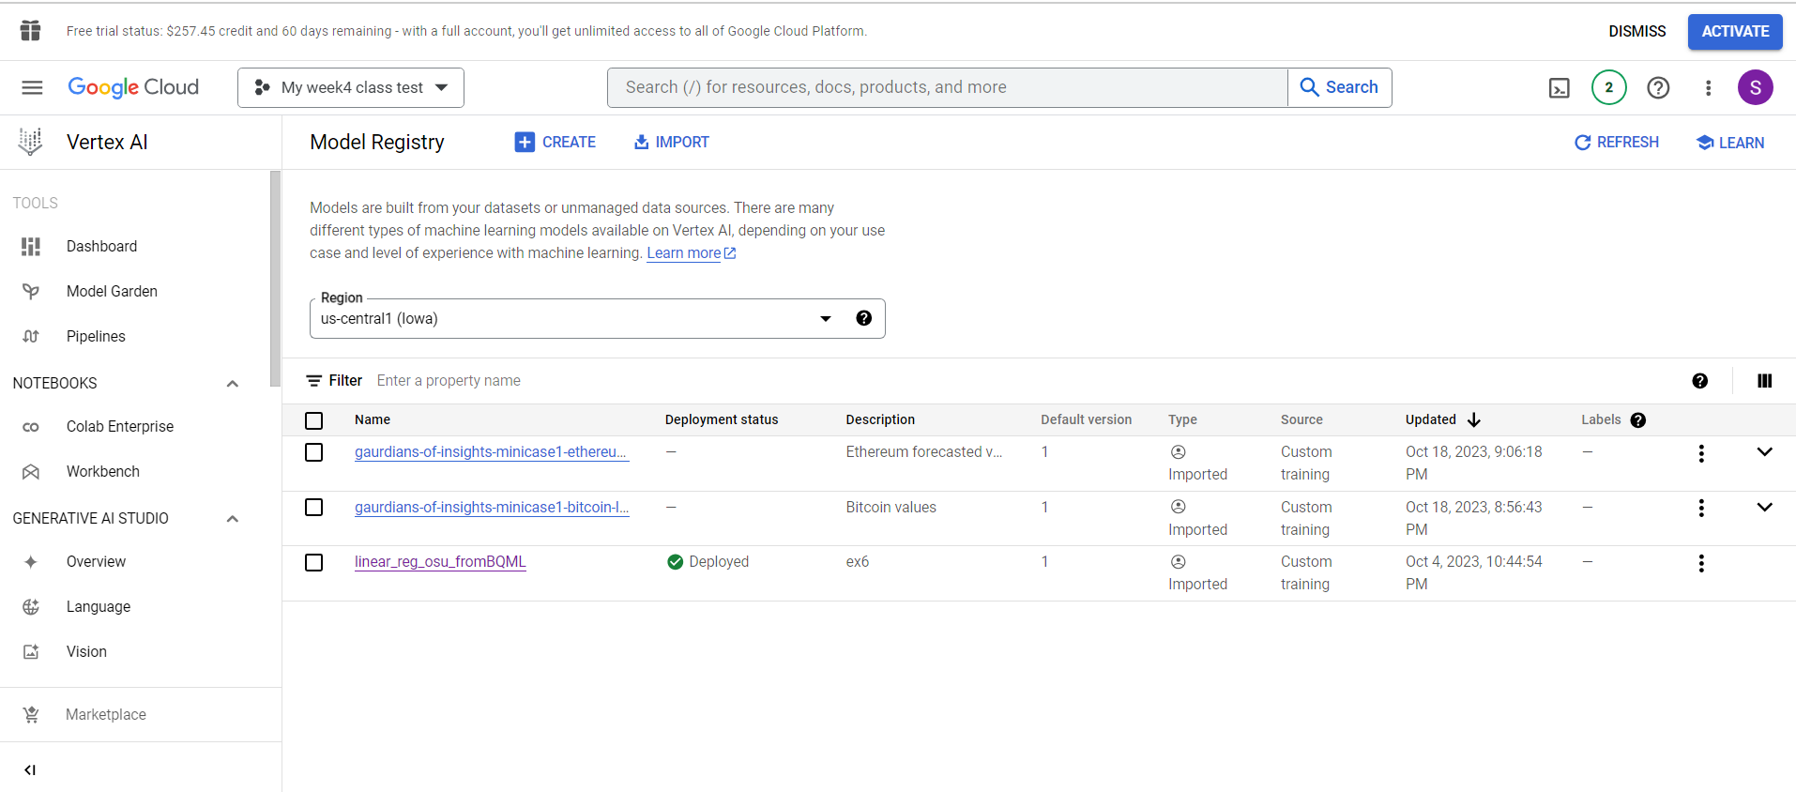
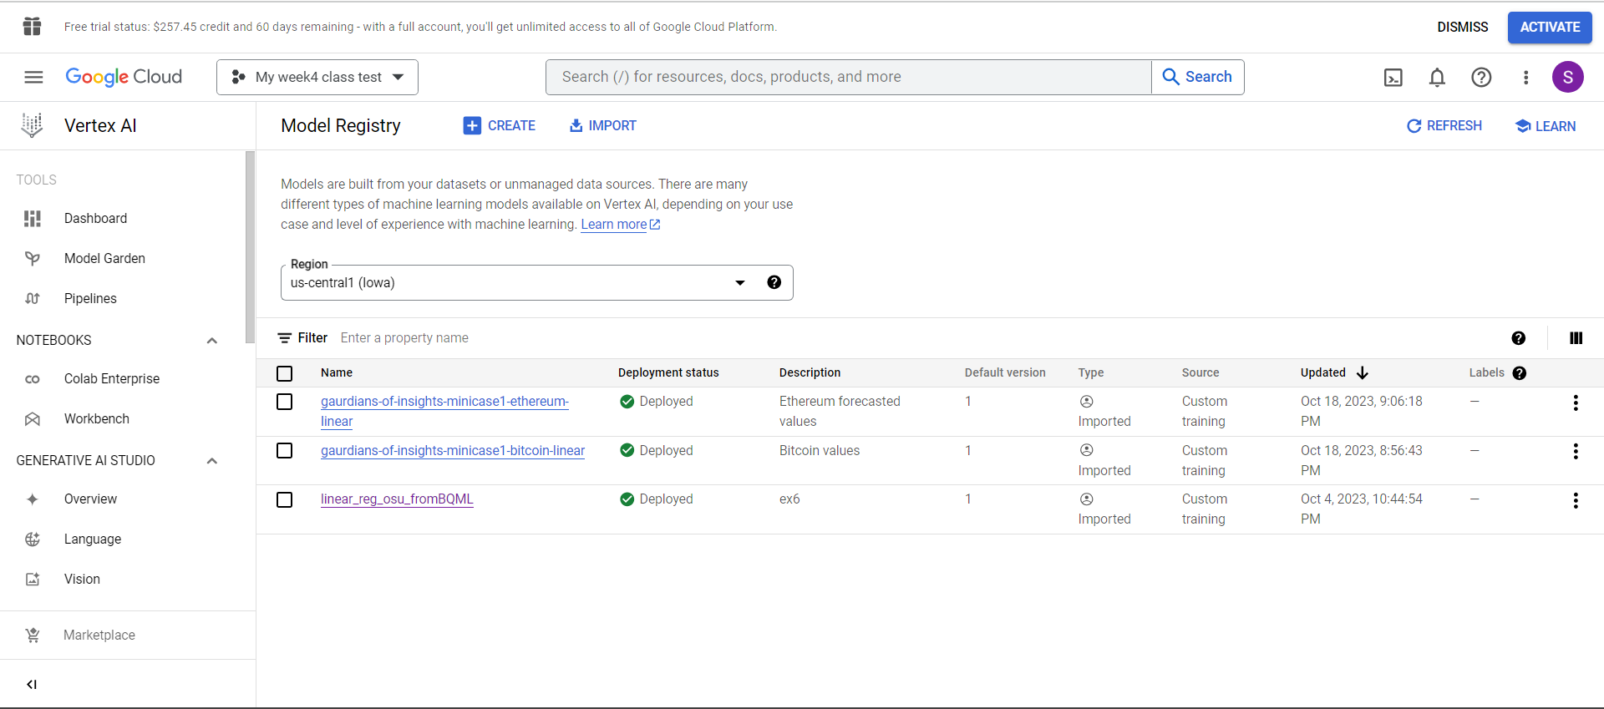
Appendix
Deployment into Vertex AI.

Slide 29
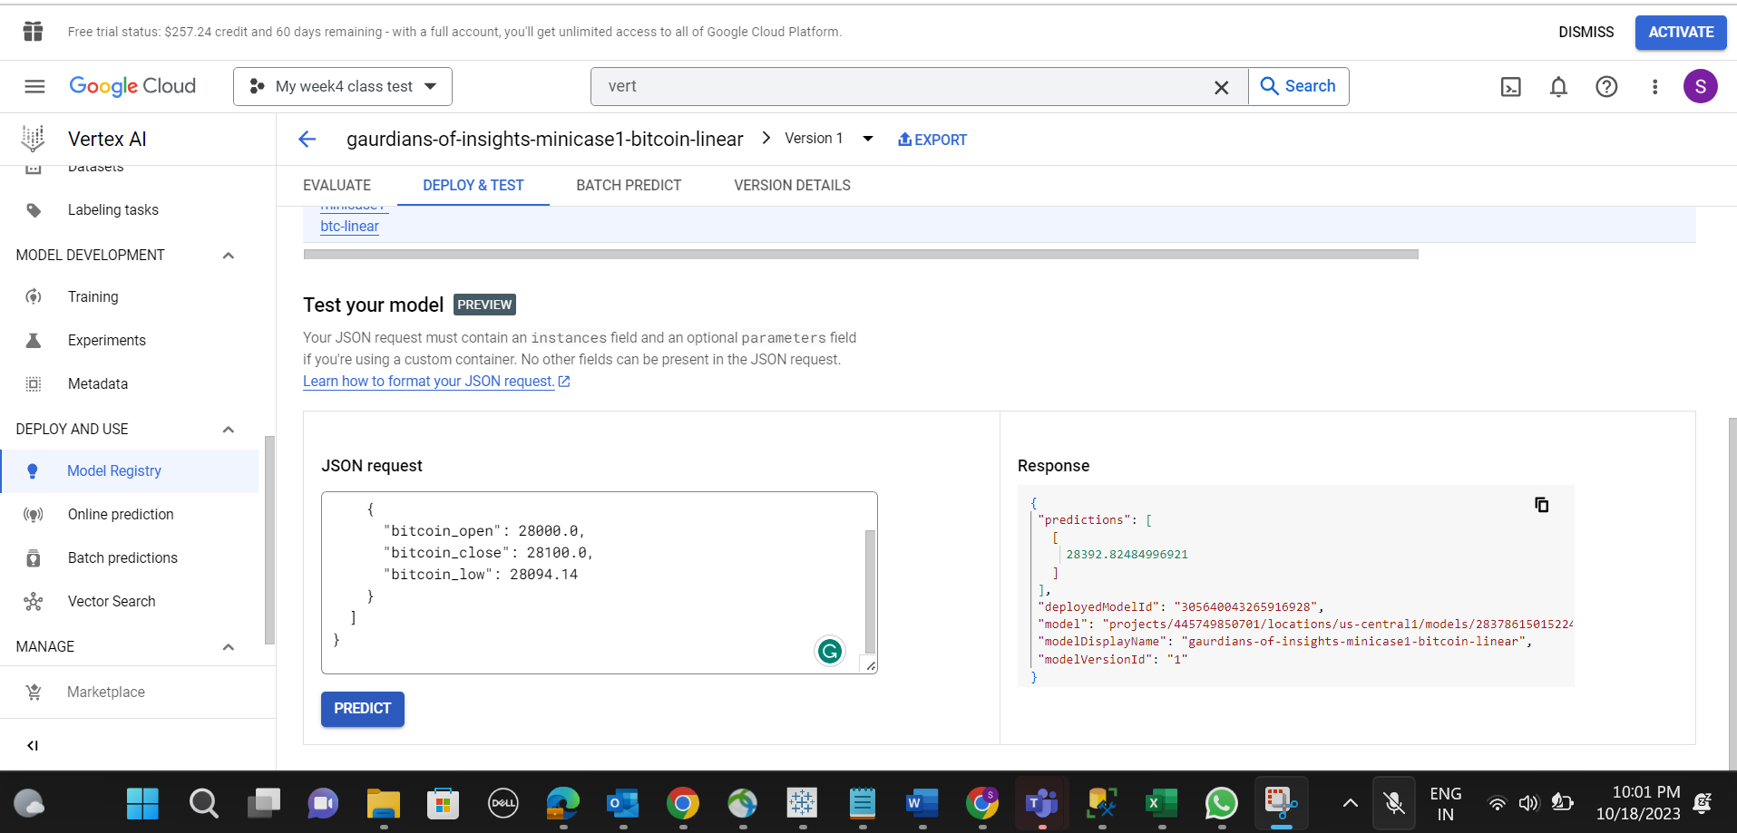
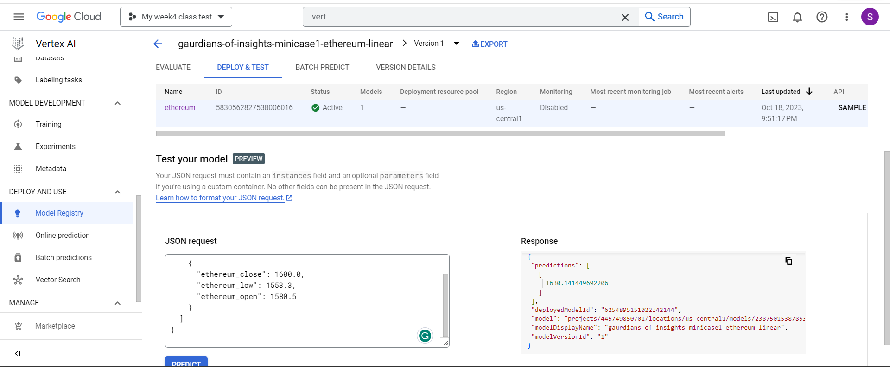
Appendix
Working script that calls the endpoint to return the predictions.

Slide 30
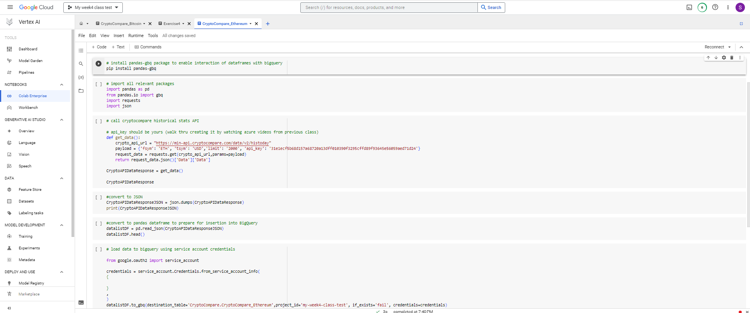
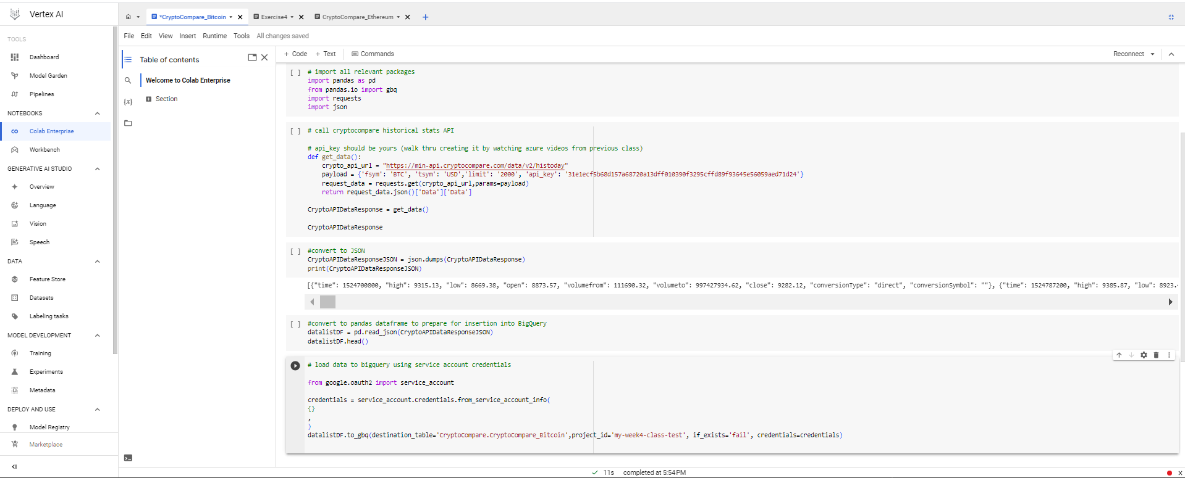
Appendix
Data sourcing into BigQuery.

Slide 31
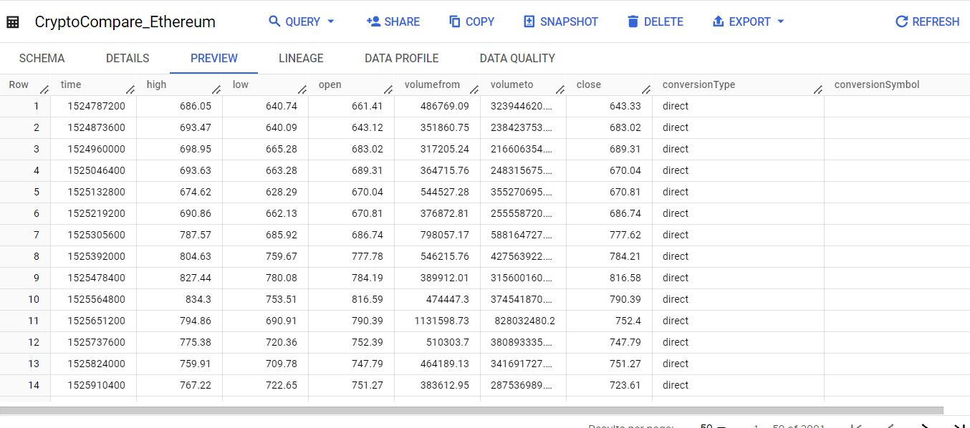
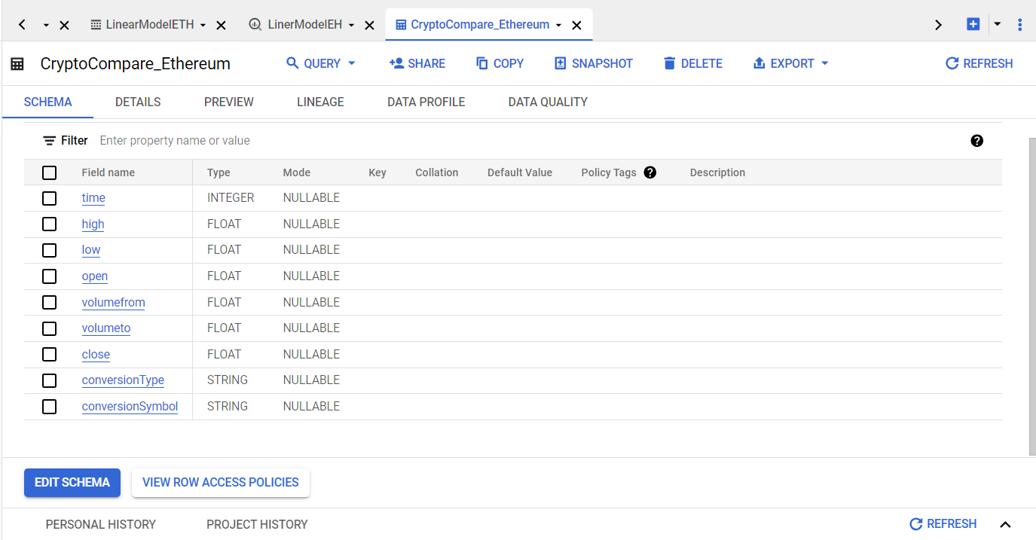
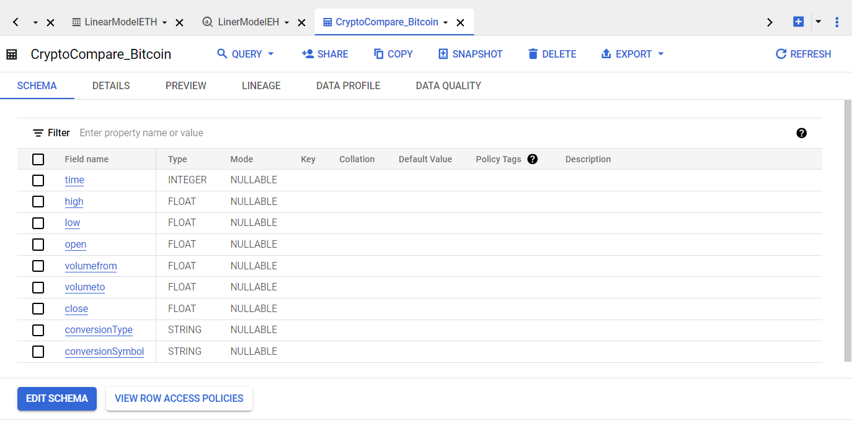
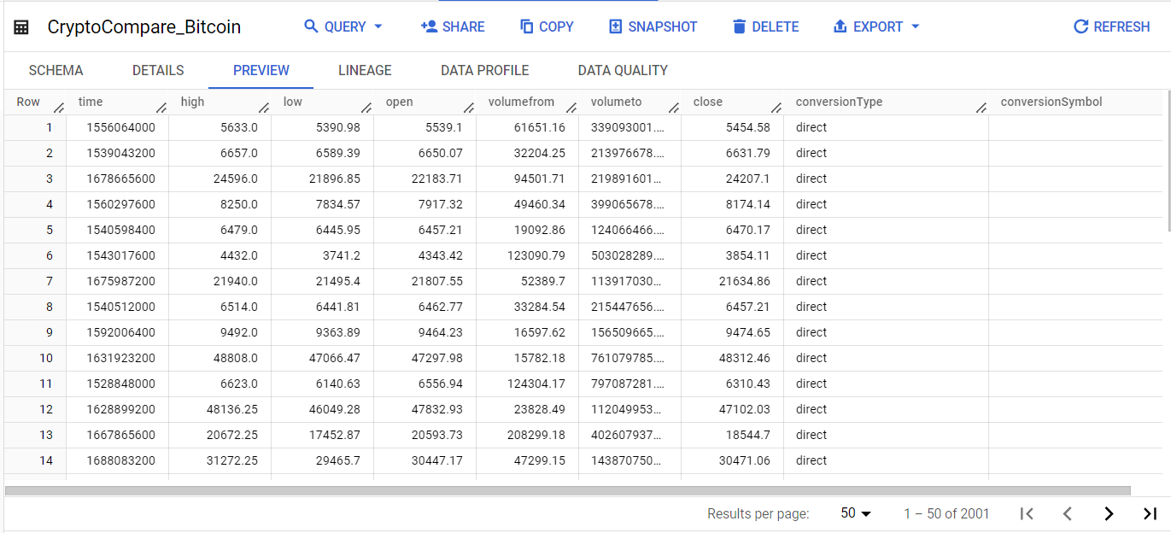
Appendix
Data preview of Bitcoin & Ethereum

Slide 32


Appendix
Full data for both cryptocurrencies

Slide 33


Appendix
Manipulating data: converting epoch time to human readable time.

Slide 34
Appendix
Combining into single table of both Ethereum and Bitcoin data

Slide 35
Appendix
Feature Engineering

Slide 36


Appendix
Variables of Importance for both models.

